Slide 1


Computer Quiz Challenge
10 Multiple Choice Questions on MS PowerPoint, Internet & Email

Slide 2

MS PowerPoint Basics
Questions 1 to 4 focus on presentation slides, placeholders, shortcuts, and views.

Slide 3

Question 1: PowerPoint Slide
What is an individual page in a PowerPoint presentation called?
A) Document
B) Slide
C) Sheet
D) Page

Slide 4


Question 2 & 3: PowerPoint Features
Q2: Slide Placeholders
Q3: Presentation Shortcut
Which area in a PowerPoint slide allows you to click and type your text or insert pictures?
Which key on the keyboard is a shortcut to start a PowerPoint Slide Show from the beginning?
A) Text Box
A) F1
B) Placeholder
B) F5
C) Frame
C) F11
D) Border
D) Enter

Slide 5
Question 4: PowerPoint Views
Which view allows you to see small thumbnail pictures of all slides on one screen?
A) Normal View: Displays the current slide for editing text and shapes.
B) Slide Sorter View: Displays miniature thumbnails of all slides for reordering.
C) Slide Show View: Displays slides in full screen for presenting to an audience.
D) Reading View: Displays slides comfortably on screen like a digital book.

Slide 6

Internet & WWW Basics
Questions 5 to 7 explore web addresses, browsers, and the World Wide Web.

Slide 7

Question 5 & 6: Internet Terms
Q5: Full form of WWW
What does the 'WWW' in a website address stand for?
A) World Wide Web
B) World Web Window
C) Wide World Web
Q6: Website Address
What is the unique address of a web page called?
A) IP Code
B) URL

Slide 8
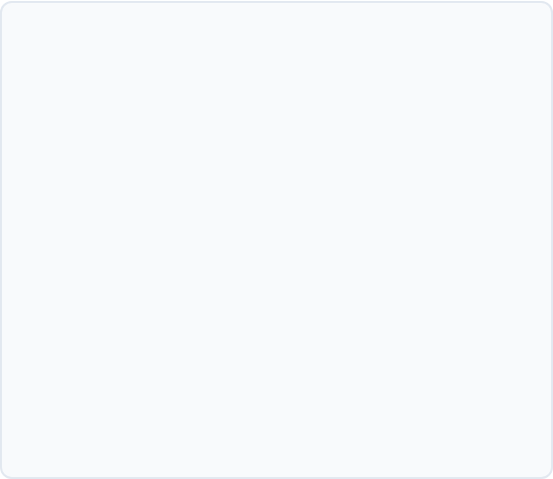
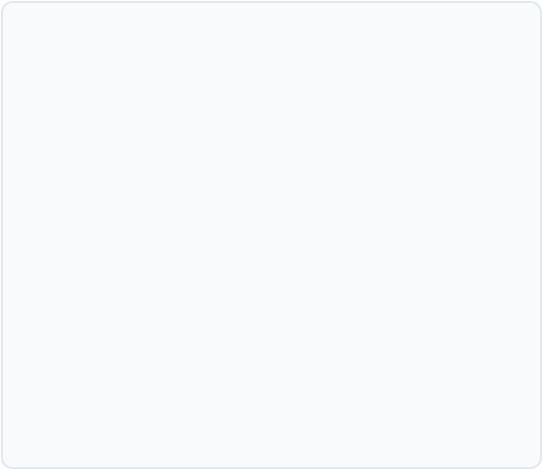


Question 7: Web Software
Question 7
Examples of Browsers
Which software program is used to open, view, and surf websites on the internet?
Popular web browsers used worldwide to surf internet websites include:
• Google Chrome
• Mozilla Firefox
• Microsoft Edge
• Apple Safari
A) Web Browser
B) Search Engine
C) Operating System
D) Text Editor

Slide 9

Electronic Mail (Email)
Questions 8 to 10 cover email terminology, mandatory symbols, and inbox components.

Slide 10

Question 8, 9 & 10: Email Basics
Q8: What is the full form of Email?
A) Electronic Mail
B) Electrical Mail
Q9: Mandatory symbol in Email?
A) # (Hash)
B) @ (At sign)
Q10: Where received messages go?
A) Outbox
B) Inbox

Slide 11
Answer Key: Questions 1 to 5
Q# | Question Topic | Correct Answer Option
Q1 | Individual page in a PowerPoint presentation | B) Slide
Q2 | Box on slide to click and type text | B) Placeholder
Q3 | Shortcut key to start Slide Show | B) F5
Q4 | View showing miniature thumbnails of all slides | B) Slide Sorter View
Q5 | Full form of 'WWW' in web address | A) World Wide Web

Slide 12
Answer Key: Questions 6 to 10
Q# | Question Topic | Correct Answer Option
Q6 | Unique address of a website | B) URL (Uniform Resource Locator)
Q7 | Program used to open and view websites | A) Web Browser
Q8 | Full form of 'Email' | A) Electronic Mail
Q9 | Mandatory symbol in every email address | B) @ (At symbol)
Q10 | Folder where received emails are stored | B) Inbox

Slide 13

Great Job!
Keep practicing and exploring MS PowerPoint, Internet & Email!

Slide 14



Image Sources
https://cdn.prod.website-files.com/61025d0c08f8a23b56de3526/692ae32ae94663035950e032_How%20to%20Use%20Stylish%20Icons%20for%20Presentations%20to%20Captivate%20Your%20Audience.webp
Source: www.inkppt.com
https://static.vecteezy.com/system/resources/thumbnails/071/868/964/small_2x/global-internet-www-icon-illustration-black-globe-with-www-letters-symbolizing-the-world-wide-web-online-network-website-internet-access-global-communication-and-digital-connection-concept-vector.jpg
Source: www.vecteezy.com
https://static.vecteezy.com/system/resources/previews/024/025/271/non_2x/email-notification-on-smartphone-in-hand-new-mail-message-in-inbox-mailing-letters-or-reading-sms-on-mobile-phone-illustration-vector.jpg
Source: www.vecteezy.com

